Slide 1

Project INplusONE Amr Tarek, Haoqian Zhang, Cedric Weibel, Ali Tarek, Abdelaziz Elemary, Han Luo, Mostafa Garana Easy and privacy preserving time banking based on smart contract
KISS Challenge
Notes:
Cedric
Why INplusOne?

Slide 2

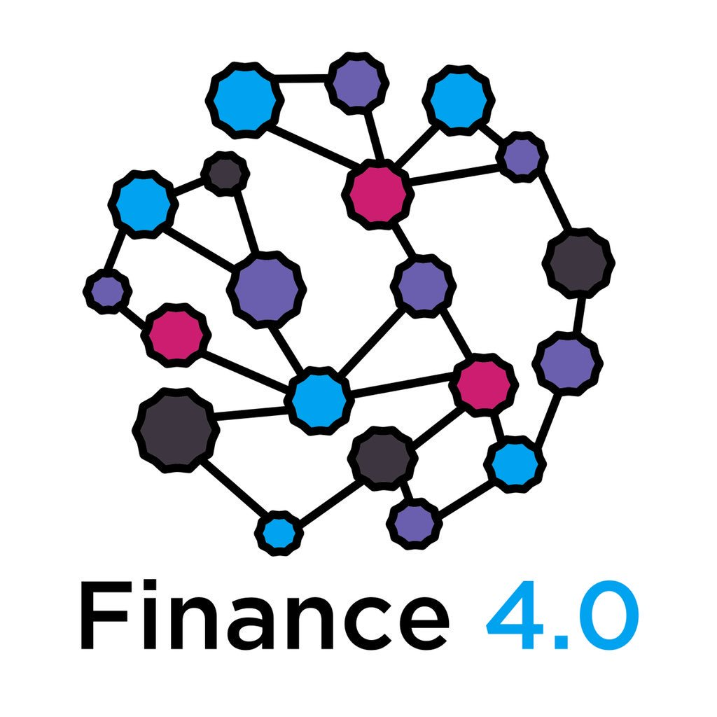




Our approach
Use time token instead of money to «exchange work»
Smart contract based system
Flexible blockchain platform
Local KISS to ensure local needs
Easy to use and self-explaining WebApp to manage given and received working hours.
KISS Geneva
EOS
Ethereum
Webapp on the smartphone or pc
KISS Zurich
Notes:
Haoqian
In our solution, we will gurantee local KISS to ensure local needs. A person who needs help in Zurich will only find a helper from Zurich, not from Geneva
Kiss can choose any blockchain system as they wish

Slide 3







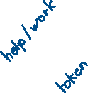

Benefits
Reliable and secured time banking
Use the tokens in a decentralized way
Various ways of using token
Ensure privacy of members in the blockchain
Automation of the paper work
Notes:
Records of contribution is trustworthy
Use tokens in a decentralized way for example as money, tax reduction or further rewards

Slide 4
Difficulties
Further improvements
Balance between privacy and analyzed data
Decision of what should be decentralized
Further services divided into categories e.g household, cooking/eating, plants, etc.
Further features like grocery lists and digital agenda
More automation
Analyzing data and provide it to companies
Even more decentralized
Notes:
Abdelaziz
Hire employees that use our app as a provider

Slide 5
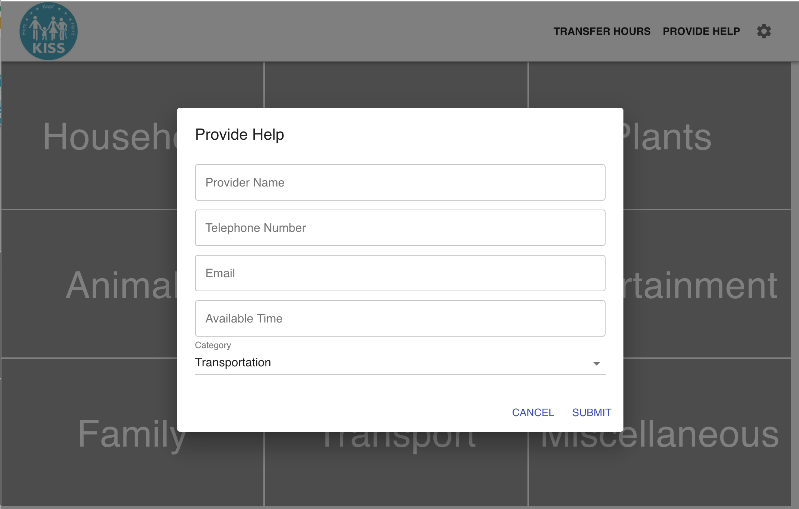
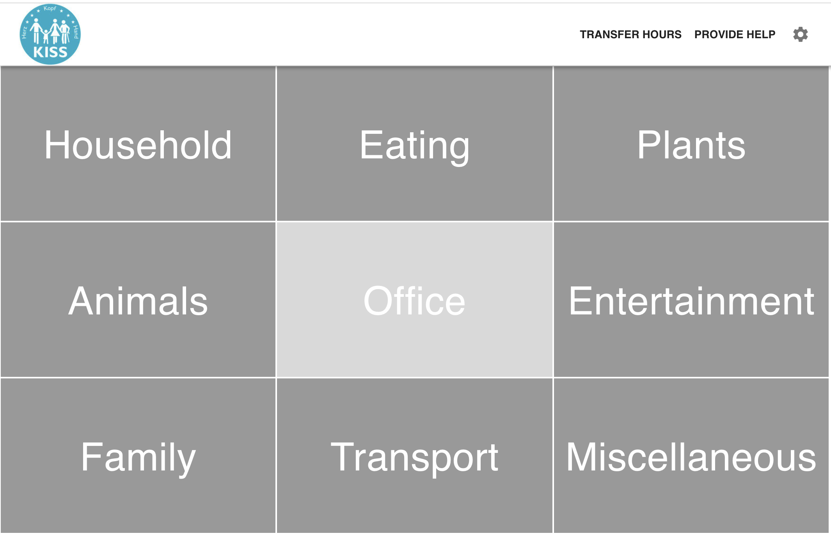
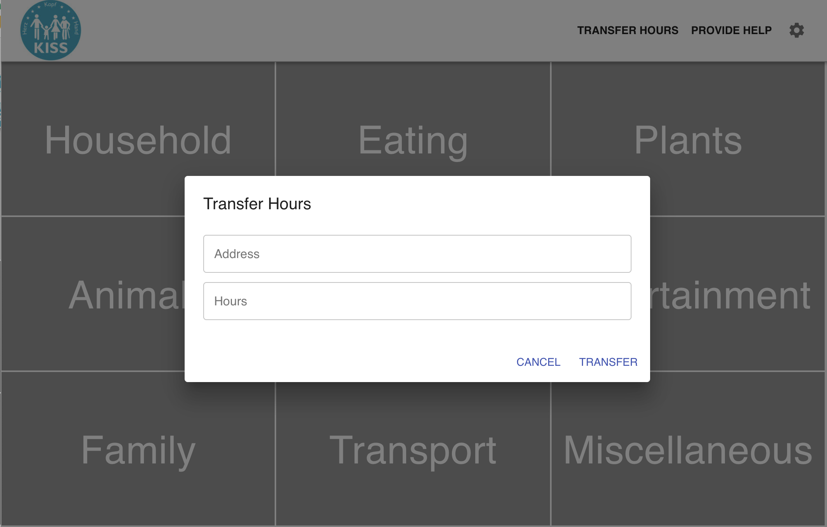
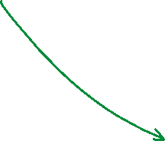

Demo
WebApp

